Slide 1
Public Relations
American Legion
Public Relations
Making it all Happen
From Your Post

Slide 2
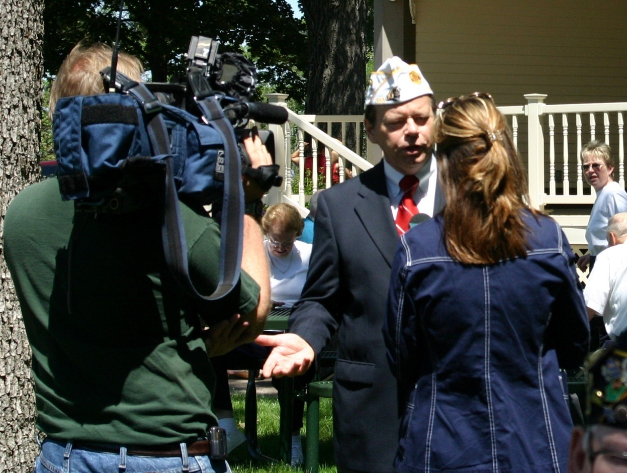
Public Relations
Make News
Notes:
We all agree -- people don’t join organizations they know nothing about,
Or, organizations that do nothing for them.
Successful organizations grow not only because they are good but because they are true practitioners of public relations.
This morning we’re going to present some ideas on making your American Legion Post not just a building in town…but the vibrant active home of busy veterans helping the community.
Its all about……..

Slide 3
Public Relations
Visibility
Advocacy
Frequency
…and they will JOIN.
Notes:
VISIBILITY.
The more often The American Legion is seen by the public…in the Newspaper
On Television,
On the Radio, or
At major public events,
the more they learn about our great programs and ADVOCACY FOR VETERANS AND THEIR FAMILIES.

Slide 4
Public Relations
Be a Newsmaker!
How to get the media to call YOU
Notes:
Churchill once said, “It is better to be making the news than taking it; to be an actor than a critic.”
How right he was. So, to get maximum visibility, become a newsmaker in your community.
Its easier than you think.
PERCEPTION IS REALITY. Do a self analysis of your Post.

Slide 5
Public Relations
National vs Local
Notes:
As a nation at war, national security if a major story. So is veterans health care.
Every town loves to localize a national story.
So, Localize -- NEXT SLIDE

Slide 6
Public Relations
Localize!
+ Press Release
Bring the story home.
Notes:
News release, interviews, local petition drive, call elected officials, etc. Comments on local VA facilities from personal experience.
HQS Website has current issues and news releases.
Become a resource for your local media in issues of importance to The American Legion. Goal: Be in your local reporter’s rolodex.

Slide 7
Public Relations
Local Headlines:
Local Veterans outraged by DHS Report
Merriville Legionnaires irked by Napolitano Report
Legion District Commander calls for report investigation
How to get them:
Localized Press Release
Media Advisory on interview availability
Refer to National Commander but use own quotes also
Email to media quickly
Use Talking Points

Slide 8
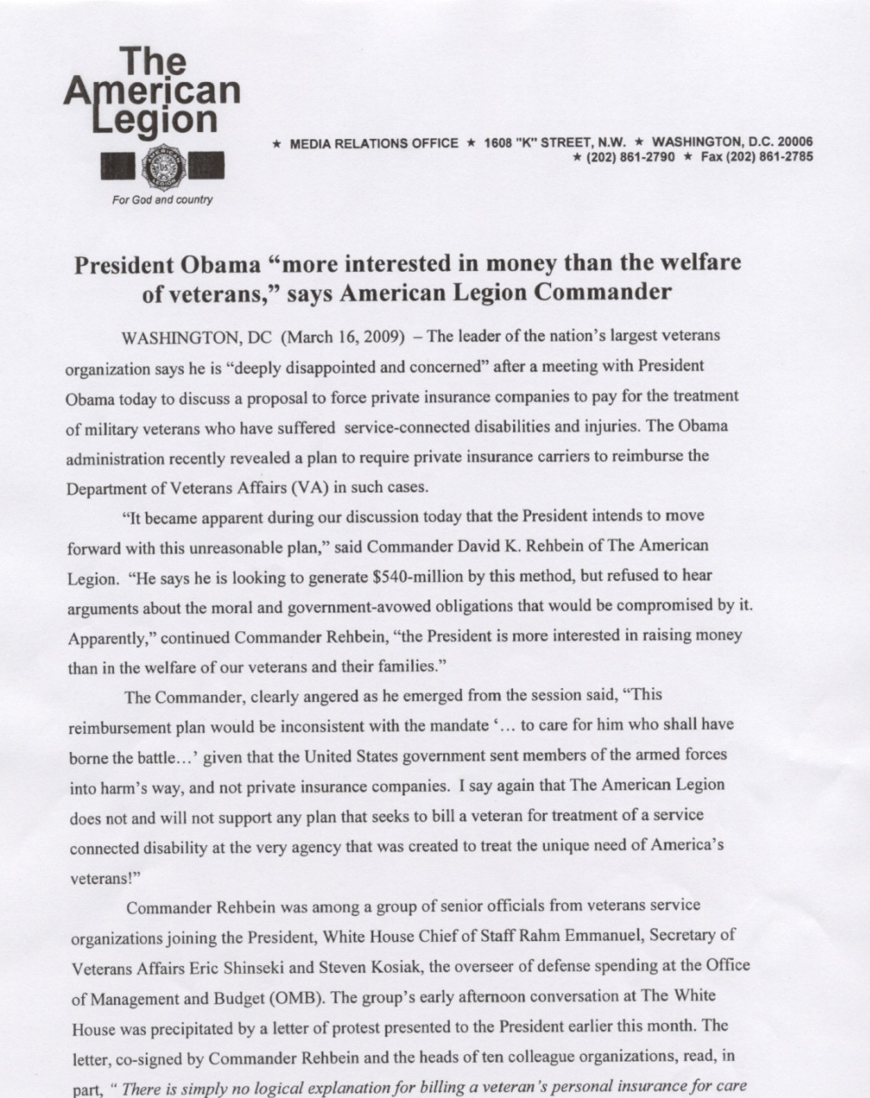
Public Relations

Slide 9
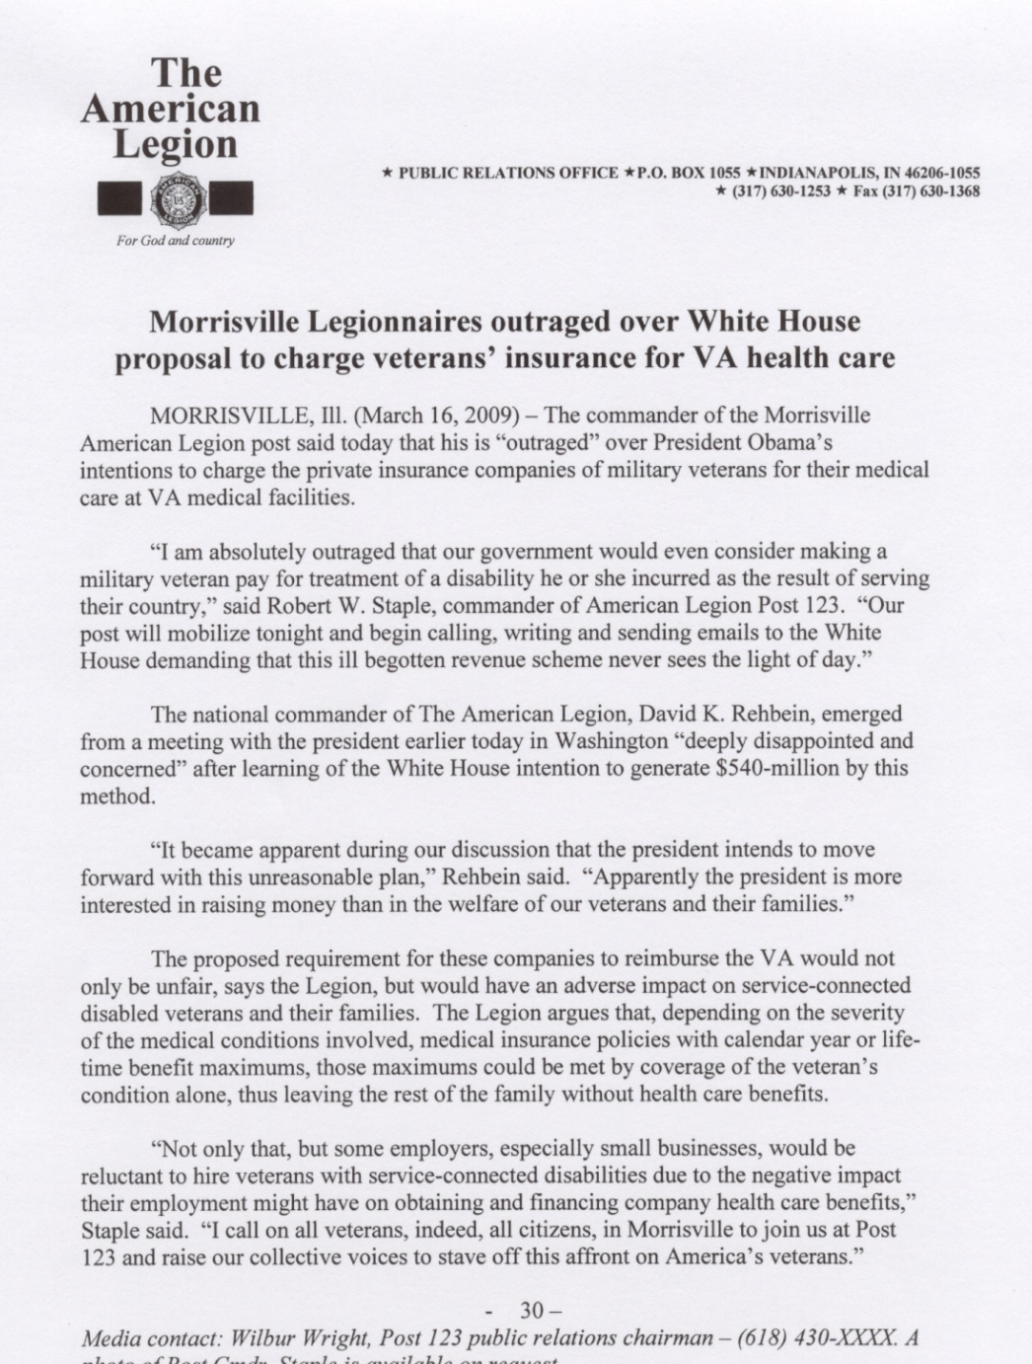
Public Relations
National Release
Local Release

Slide 10
Public Relations
Issue Awareness
Daily Commander’s Clips
National Website
Email News Releases
Legion Newscenter Twitter

Slide 11
Public Relations
Make Your Own News
Community Events:
Heroes to Hometowns
Blue Star Salute
Veterans Service Days
Disaster Preparedness Training
Town Hall Meetings

Slide 12
Public Relations
Community Visibility
In the media
AND
more ways then you may have thought.
Notes:
In addition to current issues, hold public events. In May of 2005, The American Legion will take the lead in saying ‘Thank you’ to our armed forces in Everytown, USA. I’ll discuss in a moment.

Slide 13
Public Relations
Information Campaigns:
Legiontown USA
A Powerful Force
A 3 month public outreach that will:
Show folks what your posts really do
Garner new members and increase renewals
Market two new PR/Membership tools

Slide 14
Public Relations
New PR/Membership Recruiting Tools:
Legiontown USA
The centerpiece. A publication that highlights the programs and services of American Legion Posts in communities from coast to coast.
A Powerful Force for the Nation
Targets younger veterans with education about The American Legion - an organization that promotes Veterans Affairs and Rehabilitation, National Security, Americanism and Children and Youth.

Slide 15
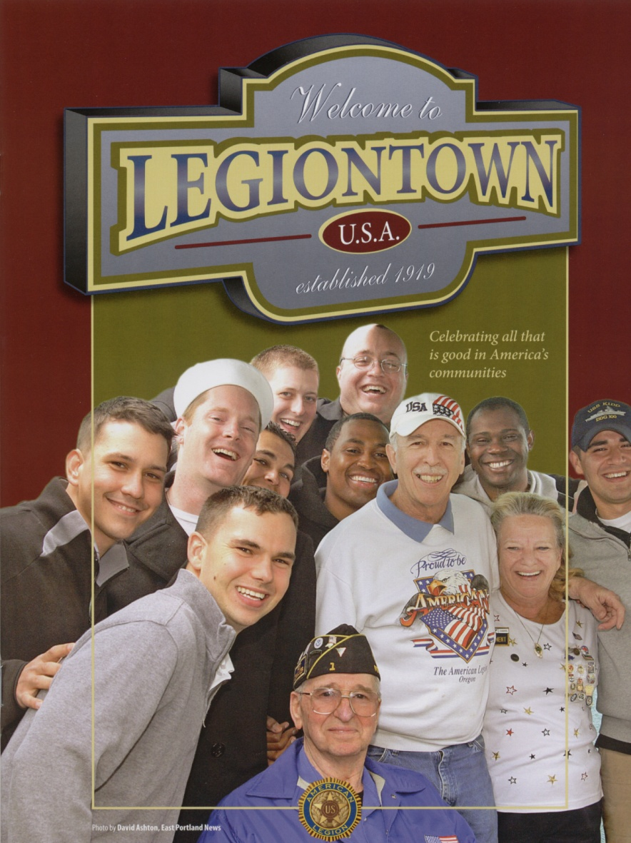
Public Relations

Slide 16
Public Relations
Both publications are available for use during the Legiontown campaign.
Ideal in showing the “service” side of TAL
Great for new veterans in finding an interest and reason to join
Eye-openers for educators, the media and community leaders

Slide 17
Public Relations
American Legion
Day
September 16

Slide 18
Public Relations
Use American Legion Day to…
Sign a Proclamation
Media Event
Promote what makes your town a Legiontown!
Tell the world at http://legiontown.legion.org/

Slide 19
Public Relations
Powerful Force Campaign
Targets younger veterans
Broadcast and print products
Marketing Guide
National Distribution
Notes:
In addition to current issues, hold public events. In May of 2005, The American Legion will take the lead in saying ‘Thank you’ to our armed forces in Everytown, USA. I’ll discuss in a moment.

Slide 20
Powerful Force Campaign
“Movers & Shakers”
Elected Officials
Public Servants
Business & Industry
Chambers of Commerce
The media
The community at large
Churches
Schools
Nonprofits
Military Units

Slide 21
Public Relations
Legiontown USA
One campaign for three months
Builds public awareness
Attracts potential members
Reinvigorates past members

Slide 22
Public Relations
Seize the Opportunity
OR
Make One
Notes:
One final thought … never fail to take advantage of the standard closing question in nearly every interview:
“Anything else that we haven’t covered that you’d like to add?”
This is the time for you to hammer-home the main message points once again.
Leave the interviewer with the clear message that this is important to you. Speak passionately…and stay on ‘point’ – the ‘message point’ that is.
Now, to talk about other media avenues, my boss and your PR Director, Joe March.

Slide 23
Public Relations
Powerful Force:
+ “Pledge to Service Video” for speaking engagements/recruiting, and more…
+ PSAs and print ads for local marketing

Slide 24
Public Relations
Make Every Town
In Your District a
“Legiontown”
Educate your community about
The American Legion’s Powerful Force

Slide 25
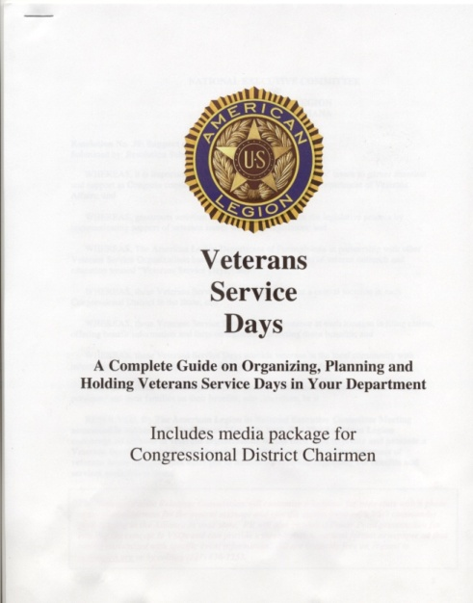
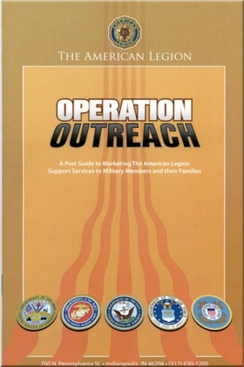
Public Relations
Make News in Your Community

Slide 26
Public Relations
Managing your
Community Image
Now You Know
Request PR Tools: pr@legion.org
Or call 317-630-1253
Notes:
Membership through Service – and good public relations.

